Slide 1
File Access
open() and write()

Slide 2
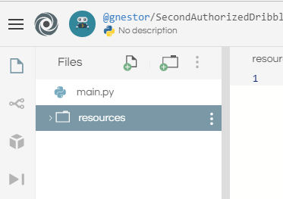
Adding a Folder to Repl
Click on "Add folder" icon
Located in top left of repl window
Name the folder "resources"

Slide 3
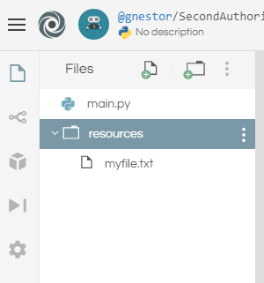
Adding a File to Repl
Click on "Add file" icon
Type "myfile.txt"
Note: Files & Folders…
may be renamed
may be deleted
drag & drop to rearrange

Slide 4
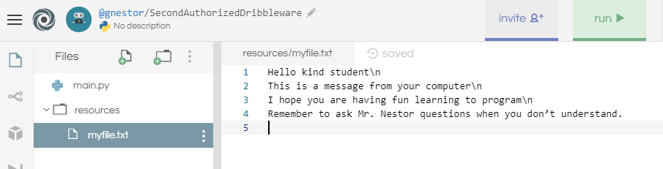
Editing a File
Select the file in the navigation window
Add or edit file contents in the edit window
Type some text
Note: "\n" is the code for a new line

Slide 5
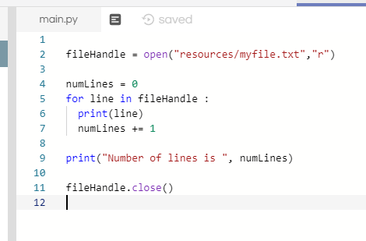
Reading a File
Try this code to read the contents of your file

Slide 6
open() Function
open() prepares the file for use in your program
You need tell it:
The name and path to your file
The mode e.g. "r"
The function returns:
A reference to your file e.g. a "handle"

Slide 7
Reading the file
There are many ways to use the File Handle to read the contents of the file
To read it line by line:
You can use a loop
The handle provides a list of lines
Google "Python Reading Files" for other ways

Slide 8
close() Function
close() will clean up the file and put it in a Safe Mode
You should close() files:
When you no longer need the file
Can be done anywhere in your program
There are no options for close()
To re-access the file you will have to open it again

Slide 9
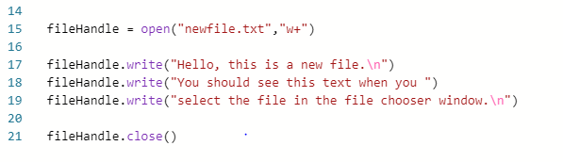
Writing a File
Try this code to create and write a new file

Slide 10
Writing a File (cont'd)
The open() function
Uses the "w+" mode
To write the file ("w") and create the file ("+")
The close() function
Must be called to save the create & write actions
Failure to close the file will result in unpredictable results

Slide 11
Writing a File (cont'd)
The write() function
Operates the same way as the print() function
It prints (writes) to the file instead of the console output
Can be used to print ASCII text and binary number data
You can call write() multiple times as needed
As long as the file is not closed using close()

Slide 12
End

